Slide 1


CLASSIFICATION OF MICE BASED ON PROTEIN EXPRESSION

Slide 2
Mice Protein Dataset

Slide 3
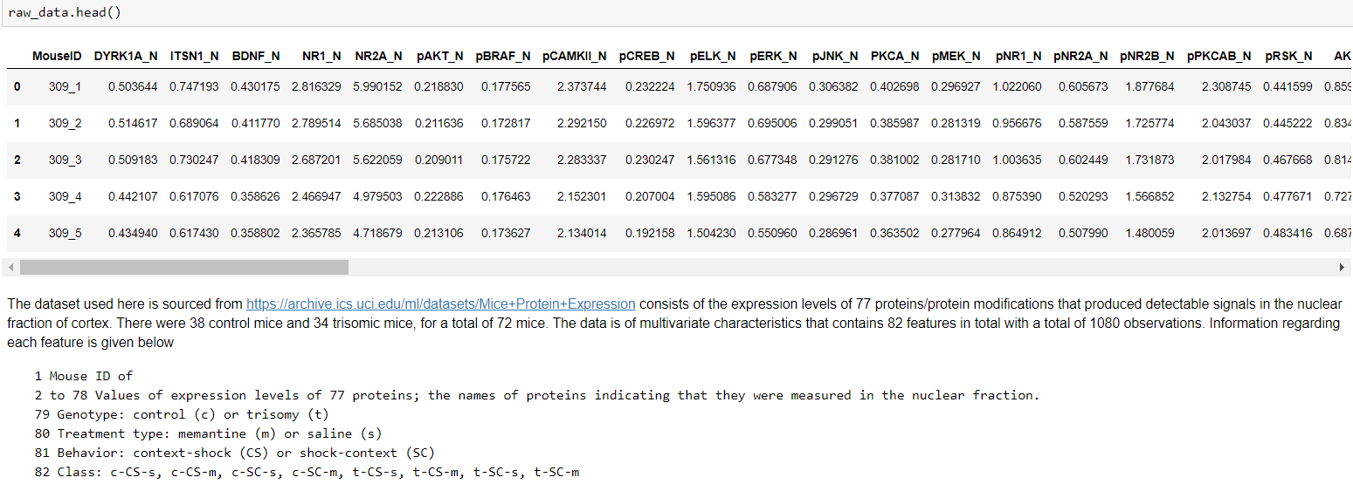

Slide 4
Data preparation
Drop Redundant Columns –’Mouse-ID’, ‘Genotype’, ’Treatment’ and ‘Behavior’
Removed observations having more than 60% missing data (3 observations)
Imputed missing data with the mean of each class for that feature.
Rightly skewed Features: Drop top 1% value
Left skewed Feature: Drop lower 0.5% value

Slide 5
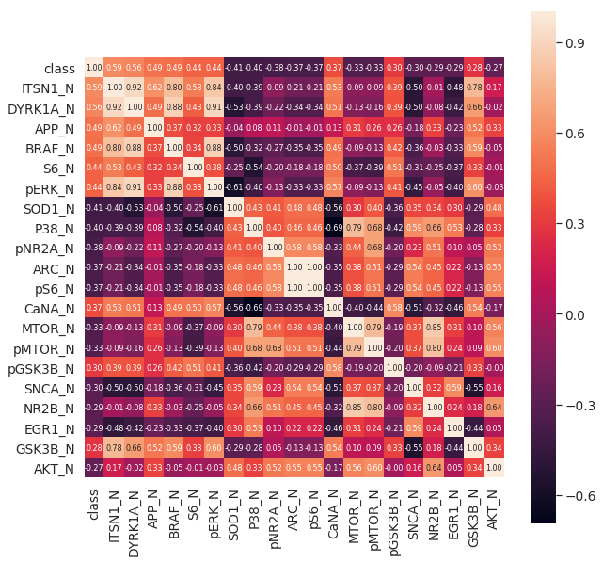
Data Exploration
Top 20 features that are highly correlated with the target i.e. ‘class’

Slide 6

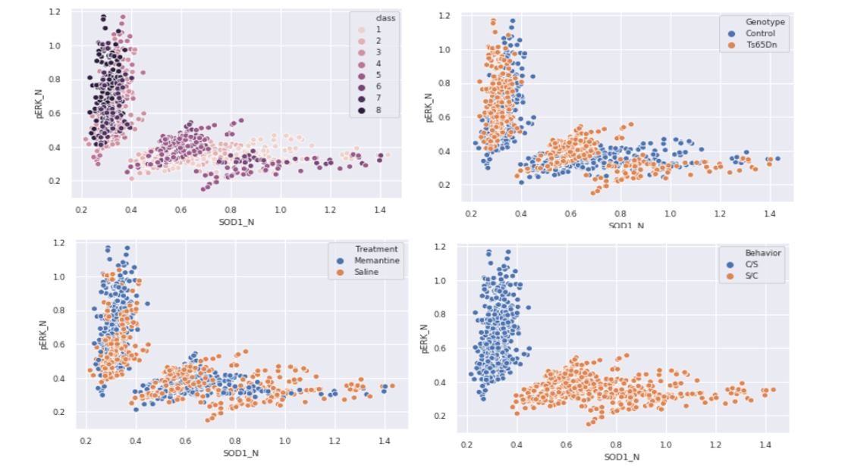
BEHAVIOR
Proteins SOD1_N, CANA_N, pERK_N are most affected with the change in the behavior (CS or SC)

Slide 7
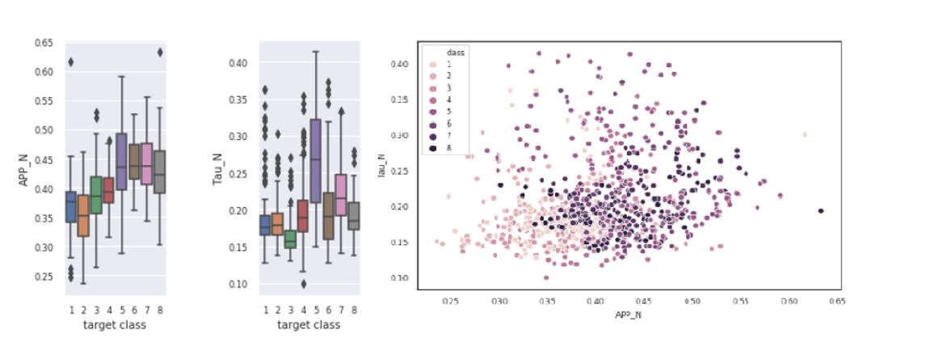
GENOTYPE
Tau_N and APP_N were able to provide information about the type of mice i.e. Control or Tri-somic

Slide 8
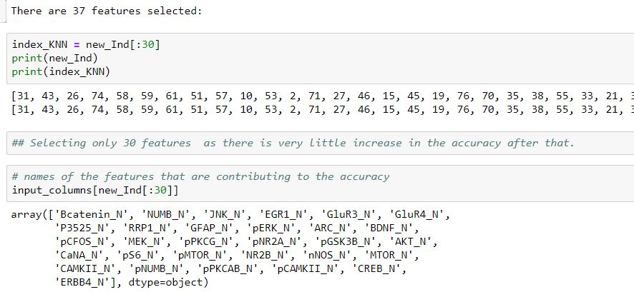
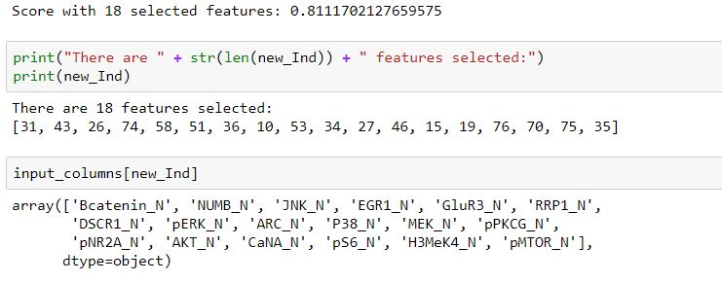
Feature Selection (Hill Climbing Technique)
KNN perform best with 30 features
DT performs with 18 features

Slide 9
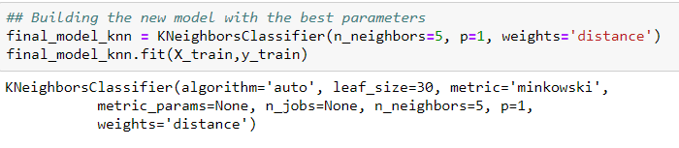
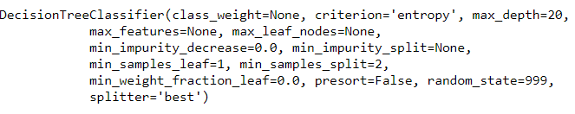
Optimal Parameters and Cross Validation
KNN best model
Hyperparameter tuning is performed in a cross validated way to get the optimal parameters that works best on the test data. Accuracy scores on the test data with these optimal parameters are further cross validated in 5-fold cross validation with 3 repetitions.
DT best model

Slide 10
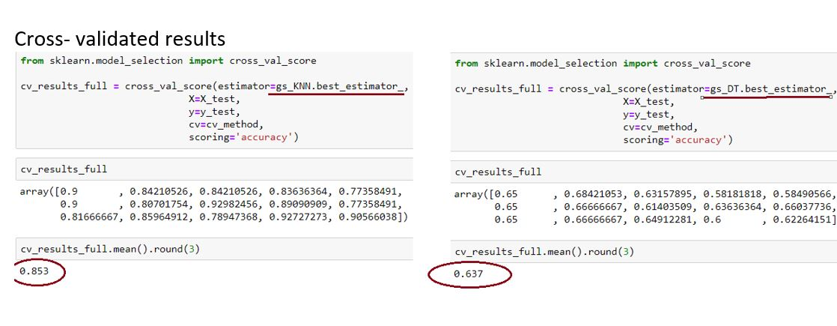
Model Evaluation
KNN model outperforms DT model in classifying different classes with a much higher accuracy score.

Slide 11
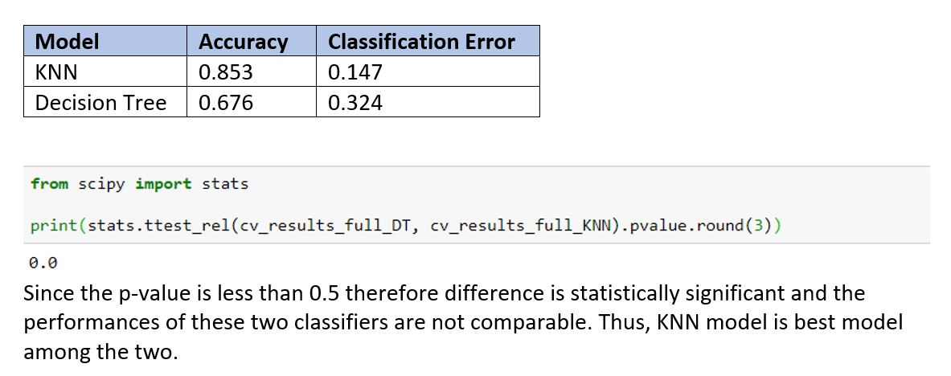
Model Comparison
To check whether the results between the 2 classification models are statistically significant or not, a Paired T-Test was performed

Slide 12
Result and Conclusion
KNN model outperforms DT model for our multi-classification problem
DT model is not suited in case where the descriptive features have continuous values.
Not all the proteins profiles that deals with the associate learning in our dataset gives much information about the different classes. Only a handful number of proteins impact the learning abilities (SOD1_N impact the learning behavior most) in mice.
Accuracy of the models can be increase further by further expanding the hyperparameter search space by including other parameters of this classification method.

Slide 13
References
Archive.ics.uci.edu. 2020. UCI Machine Learning Repository: Mice Protein Expression Data Set. [online] Available at: <https://archive.ics.uci.edu/ml/datasets/Mice+Protein+Expression> [Accessed 1 June 2020].
Higuera, C., Gardiner, K. and Cios, K., 2015. Self-Organizing Feature Maps Identify Proteins Critical to Learning in a Mouse Model of Down Syndrome. PLOS ONE, 10(6), p.e0129126. https://journals.plos.org/plosone/article?id=10.1371/journal.pone.0129126#sec011
Ahmed, M., Dhanasekaran, A., Block, A., Tong, S., Costa, A., Stasko, M. and Gardiner, K., 2015. Protein Dynamics Associated with Failed and Rescued Learning in the Ts65Dn Mouse Model of Down Syndrome. PLOS ONE, 10(3), p.e0119491. https://journals.plos.org/plosone/article?id=10.1371/journal.pone.0119491

Slide 14
THANKS

